Slide 1
Day 11
Trajectory Generation

Slide 2
Inverse Kinematics Recap
Solve for the first 3 joint variables q₁, q₂, q₃ such that the wrist center o_{c} has coordinates
Using the results from Step 1, compute
Solve for the wrist joint variables q₄, q₅, q₆ corresponding to the rotation matrix

Slide 3
Path Generation
a path is defined as a sequence of configurations a robot makes to go from one place to another
a trajectory is a path where the velocity and acceleration along the path also matter

Slide 4
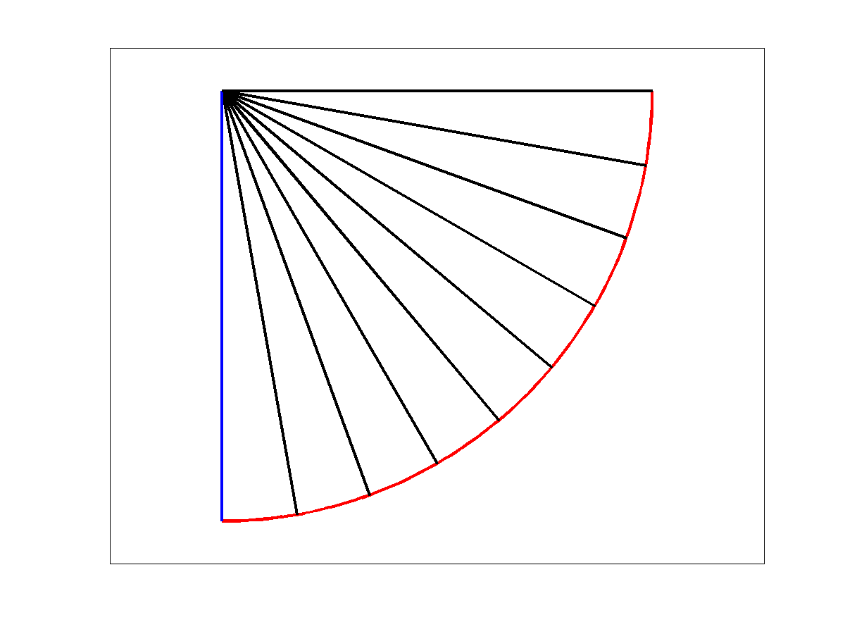
Joint-Space Path
a joint-space path is computed considering the joint variables
link 2
link 1
end effector path

Slide 5
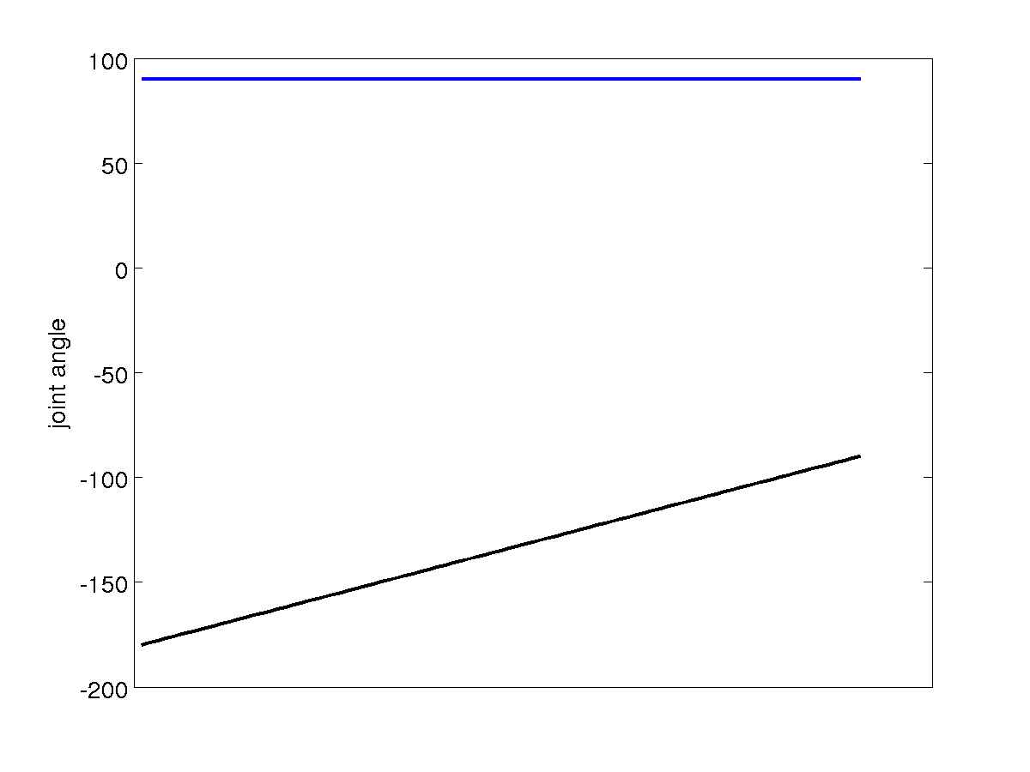
Joint-Space Path Joint Angles
link 1
link 2

Slide 6
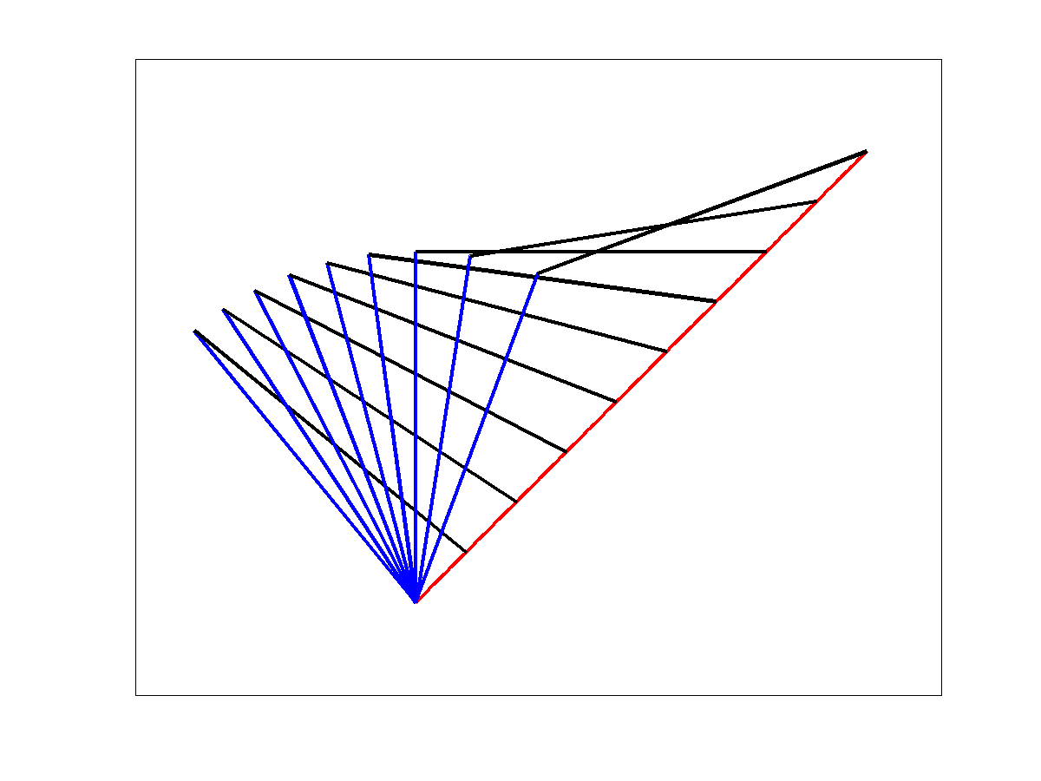
Cartesian-Space Path
a Cartesian-space path considers the position of end-effector
link 2
end effector path
link 1

Slide 7
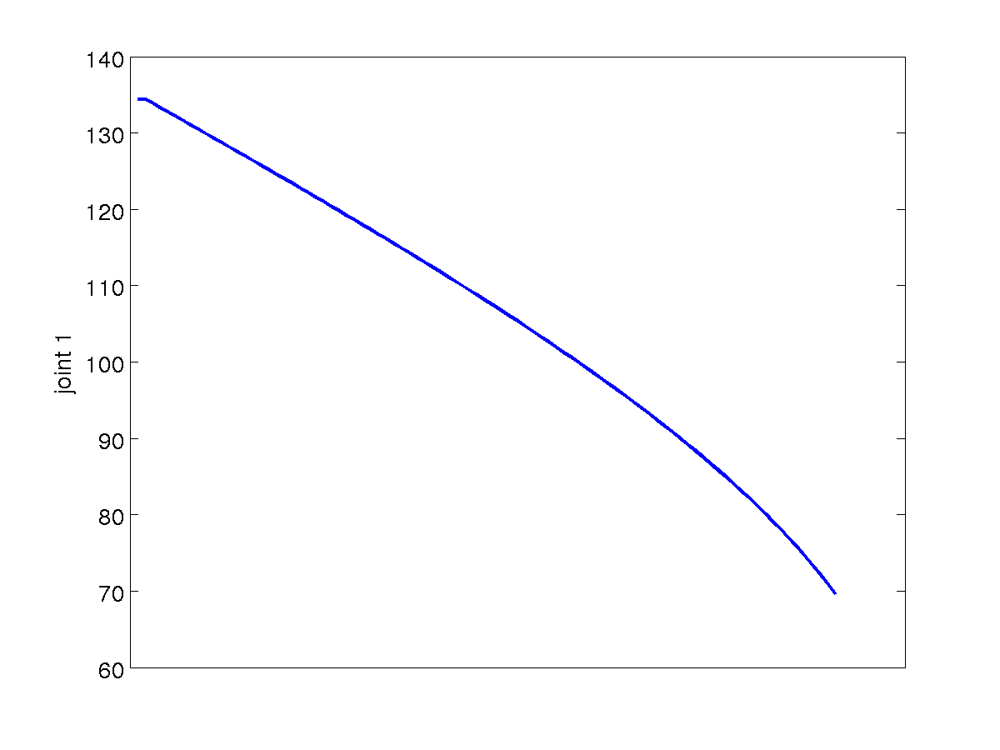
Cartesian-Space Path Joint Variable 1

Slide 8
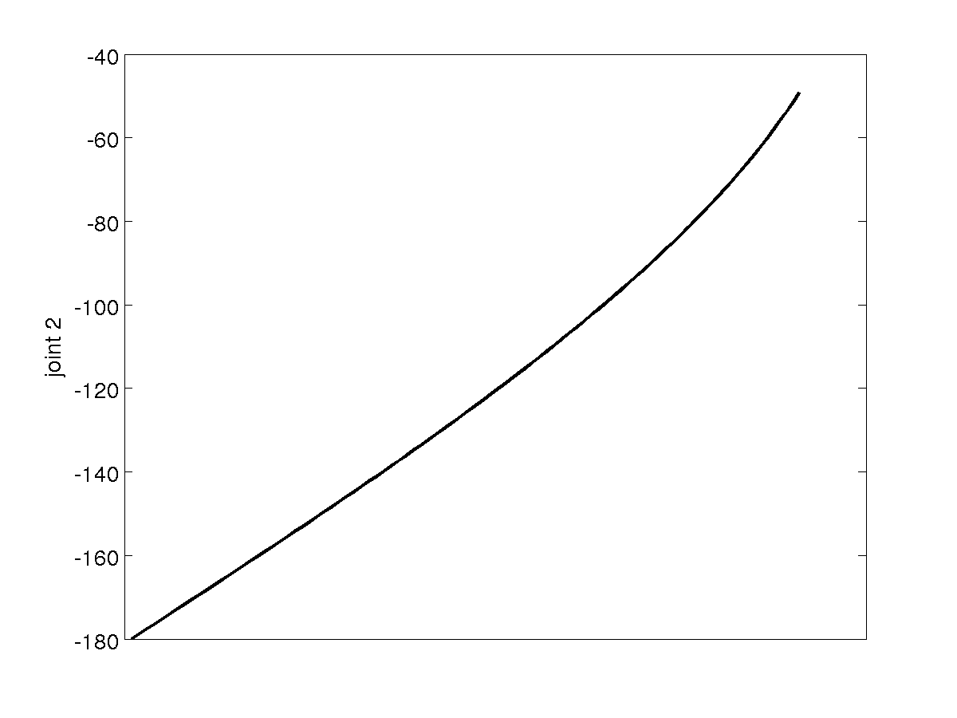
Cartesian-Space Path Joint Variable 2

